Slide 1

Ratings prediction model
By:
NITIN SINGH TATRARI
Batch no. : 1825

Slide 2
Problem statement:
we are trying to develop a rating system to predict the rating for the reviews. The rating will be given out of 5 stars- 1star, 2star, 3star, 4star & 5star. Websites where there were only reviews given, we can now classify the reviews into five categories by giving them ratings (1 to 5).
92% of consumers now read online reviews and About 40 percent of customers even say they wouldn’t buy electronics without reading online reviews. Thus, collection of ratings and reviews can be used as an immensely powerful tool for the business.
Even bad reviews can be helpful for stores. It helps customers know what the worst scenario they can expect and serve as risk mitigators.
Today’s shoppers trust the reviews of strangers more than they trust the advertisement from a company.
By taking advantage of your customer reviews & ratings, your business can monitor and improve brand awareness, reputation, and loyalty.
By collecting and publishing authentic customer feedback, businesses can help drive higher SEO, generate new customers, and increase sales
Through reviews, businesses can utilize this meaningful and useful information from their own customers to help create more effective strategies. By integrating customer feedback into the brand and marketing strategies of your business, you will stay ahead of the competition and enhance experience management

Slide 3
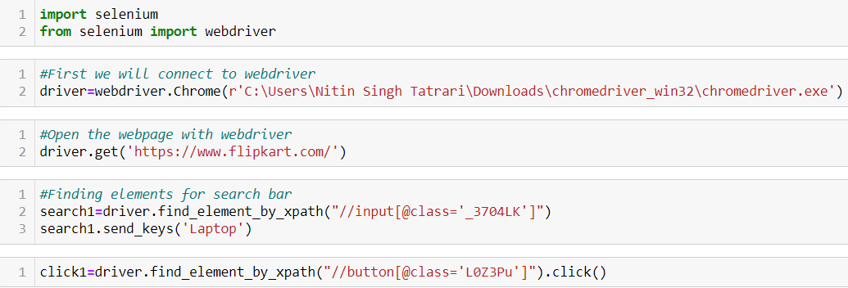
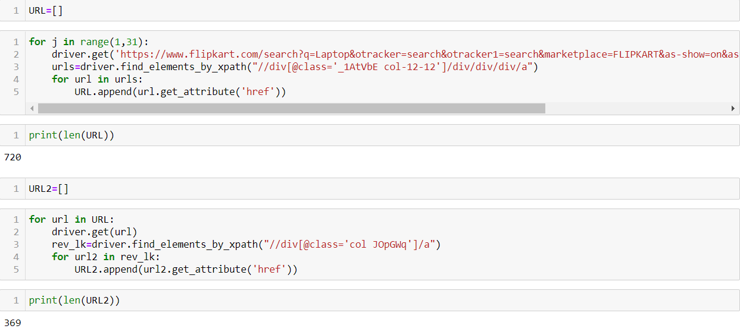
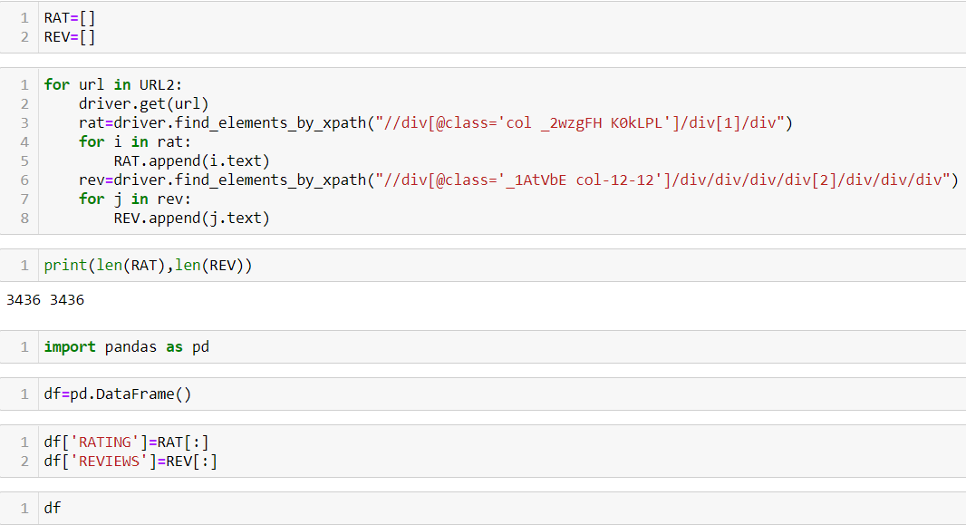
Steps followed(1): Webscrapping
Here, we are trying to scrap all reviews with ratings for ‘Laptop’ from Flipkart website.
Similarly, we follow the same steps for other products.

Slide 4
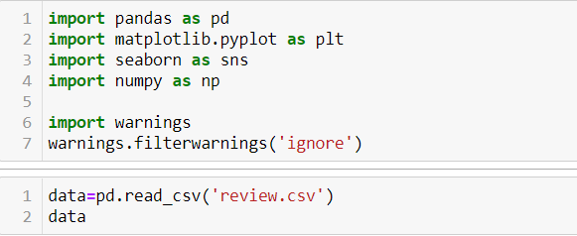

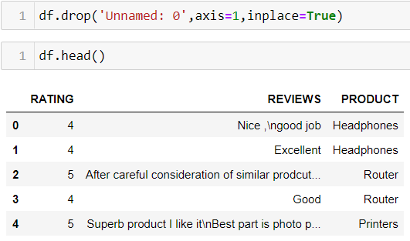
(2)Loading the data
Firstly, we import all librabries
Then we load the data from ‘review.csv’.
We load the data into Data Frame ‘df’.
We drop the ‘Unnamed: 0’ column from the data frame

Slide 5

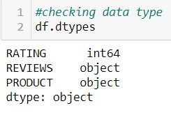
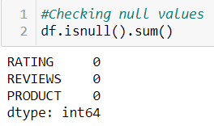
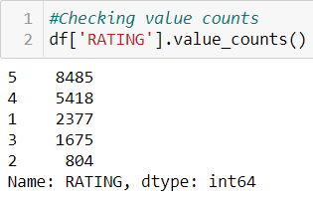
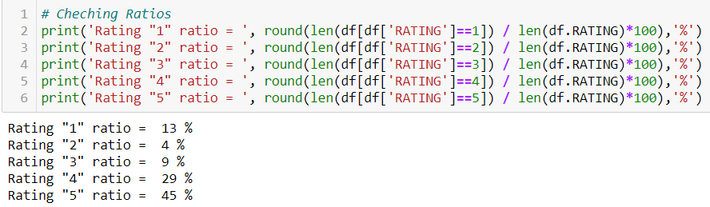
(3)Understanding the data
Data frame have 18759 rows and 3 columns
RATING is in integer type, REVIEWS & PRODUCT are in string type
There is no null values
I have try to balance the data at scrapping stage, but still reviews with rating 5 & 4 are very high as compare with reviews with rating 1,2 & 3

Slide 6
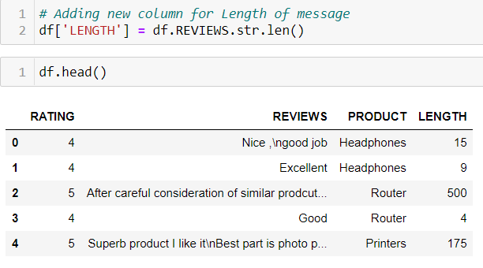
We add column ‘LENGTH’ to the data frame which describes the length in each reviews.

Slide 7

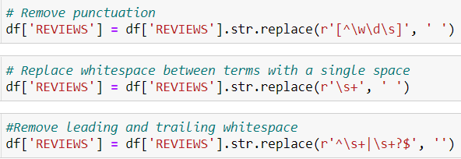
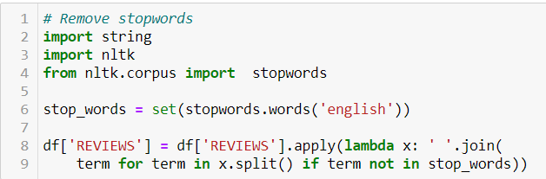
(4) Cleaning the data
We convert all string in reviews into lower
We remove all punctuation and whitespace from the reviews
We remove all stop words from the reviews

Slide 8
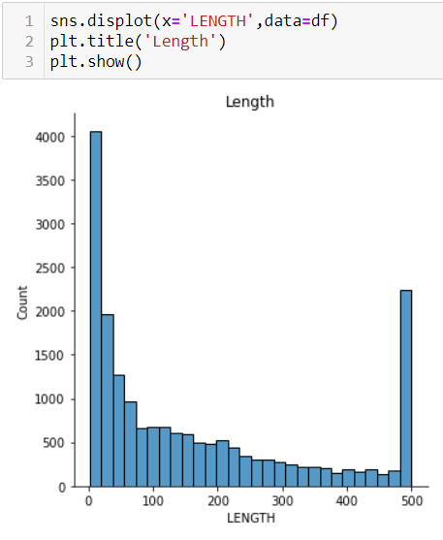
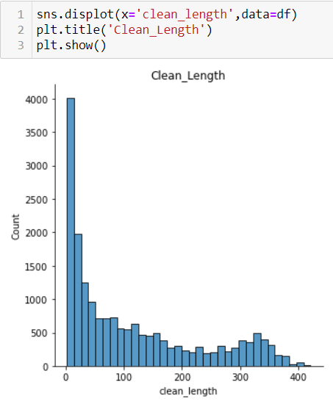
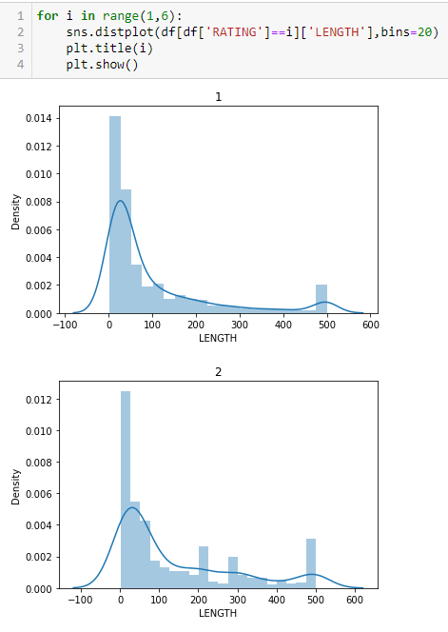
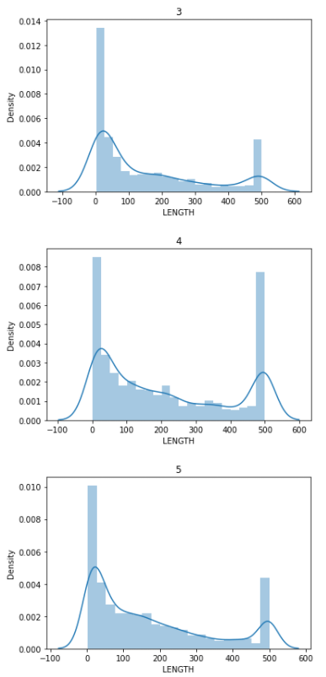
(4) Graphical analysic
We can see the length is reduced after cleaning. Maximum length of 500 is reduced to around 400 after cleaning.
All ratings have maximum frequency at 0-20 length. Second highest frequency in 4 & 5 rating at range of 500 lengths.

Slide 9
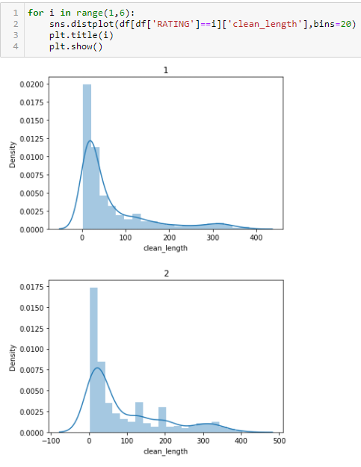
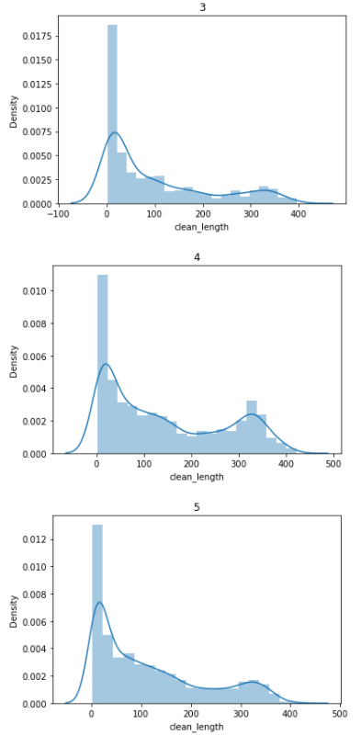
The clean length also has the maximum frequency at 0-20 range.
Second highest frequency is also reduced and it’s now in range in 20-60 range.

Slide 10
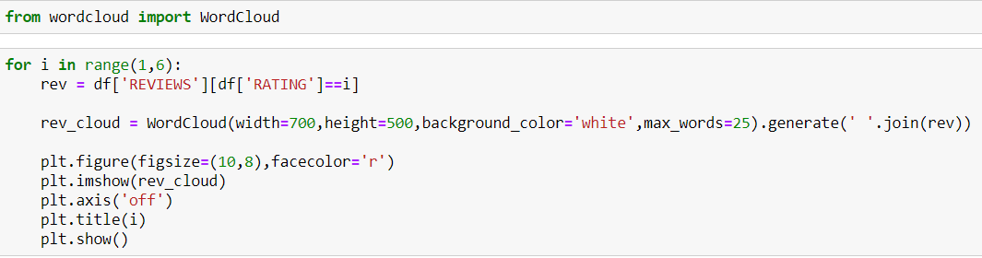
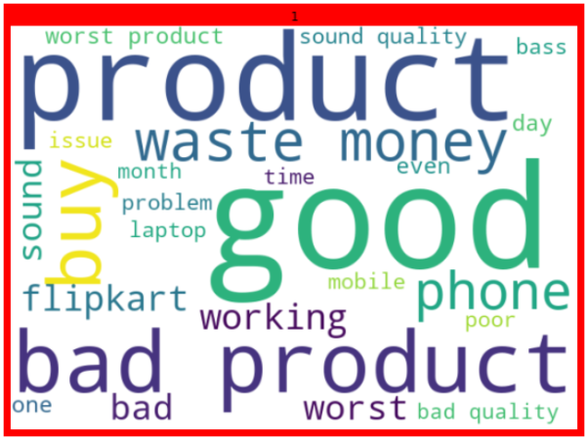
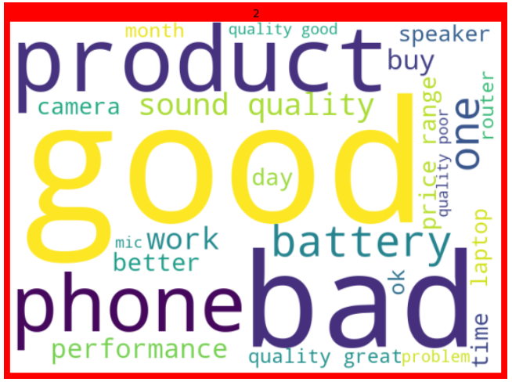
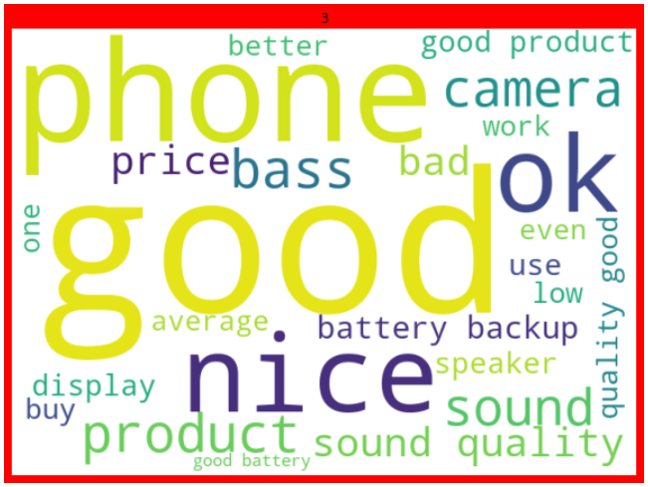
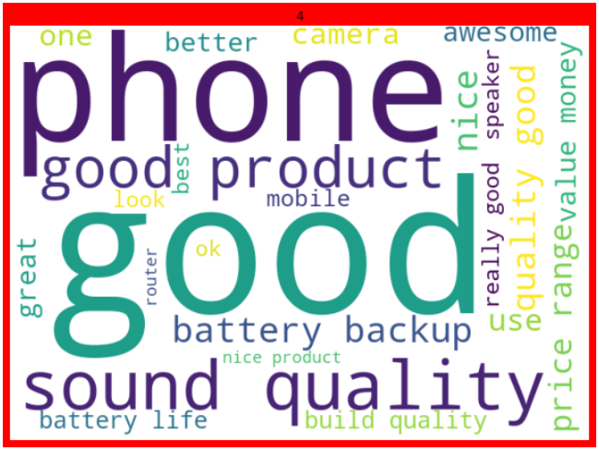
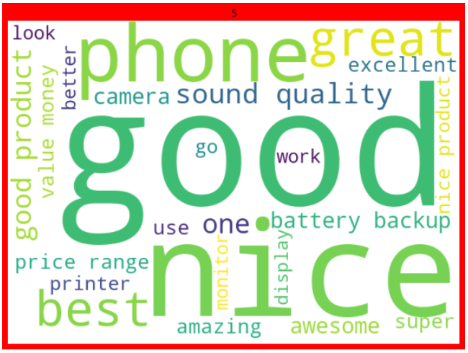
Above we can see 25 most occurring word in reviews all ratings.

Slide 11
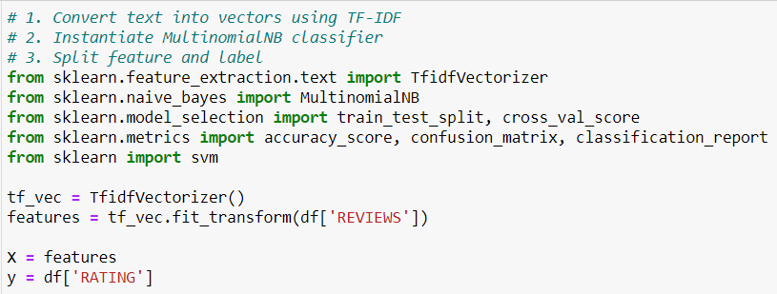
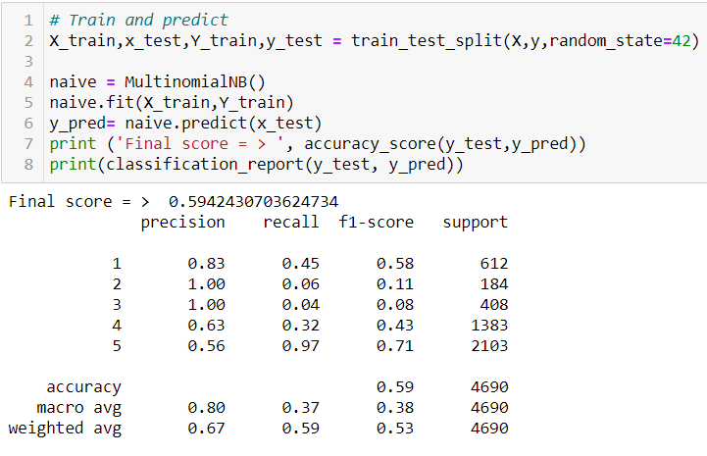
(5) Model Selection
We have import all the algorithms. We have converted the text in REVIEW column into vectors which will be used to fit machine algorithm for prediction.
We have train the model in Multinomial Naives bayes algorithms.
It give low accuracy score of 59%.

Slide 12
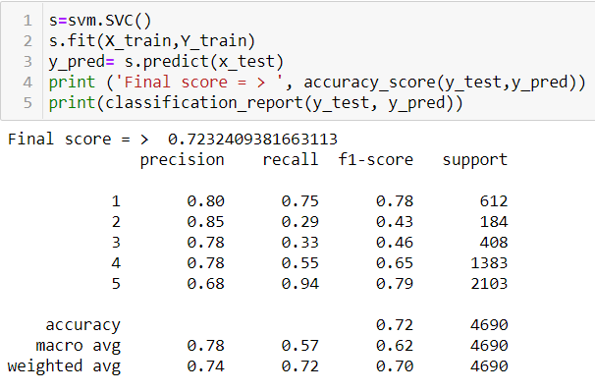
We test and train with Spaced Vector Classifier algorithm.
It gives a score of 72%.

Slide 13
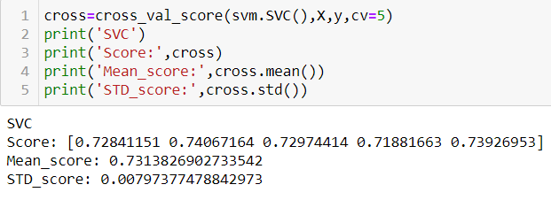
(6) Cross Validation
Since SVC gave better score, we cross validate its score.
It gives satisfactory result.

Slide 14
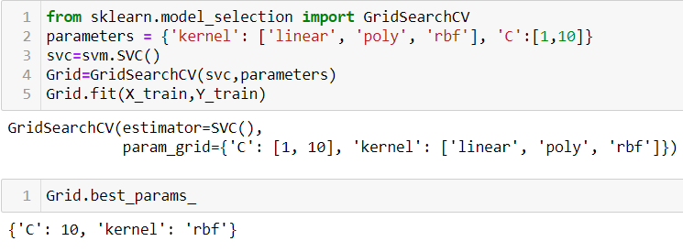
(7) Hyperparameter tunning
By applying Grid search CV, we found the best parameter for SVC algorithm is in radial basis function kernel and penalty parameter ‘C’ =10.

Slide 15
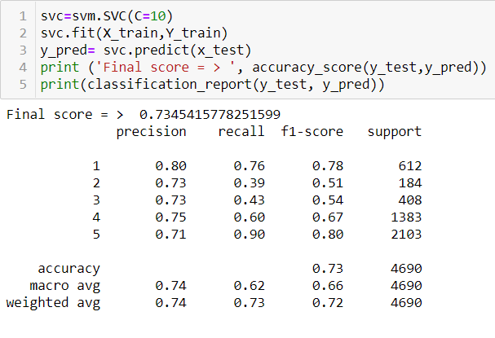
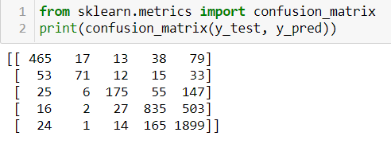
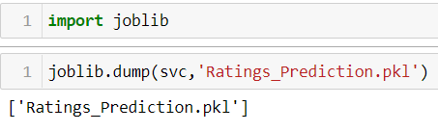
(8) Saving the best model
Applying best parameter in SVC, we got the accuracy score of 73%
We save the model using joblib

